Slide 1
3D Image Segmentation and Quantification of Lysosomes
Comparison manual.VS. automatic
4/12/2025

Slide 2
FILES
40A_UAS-TMEM1923x-HA x 71G10 40A MARCM_L3_1_Airy_010724
Airy scan_40A_UAS-TMEM-HA_CB_0h_1_051222
Airy scan_40A_UAS-TMEM-HA_CB_0h_2_051222
Airy scan_40A_UAS-TMEM-HA_CB_4h_1_051222
Airy scan_40A_UAS-TMEM-HA_CB_4h_2_051222
TMEM-HA 6h CB airy_3_170722
40A_UAS-TMEM192-3xHA x 40A 71G10 MARCM_around 12h - for quantification_4 Airy-CBs_300425
40A_UAS-TMEM192-3xHA x 40A 71G10 MARCM_around 12h - for quantification_3 Airy-CBs_300425

Slide 3
40A_UAS-TMEM1923x-HA x 71G10 40A MARCM_L3_1_Airy_010724

Slide 4
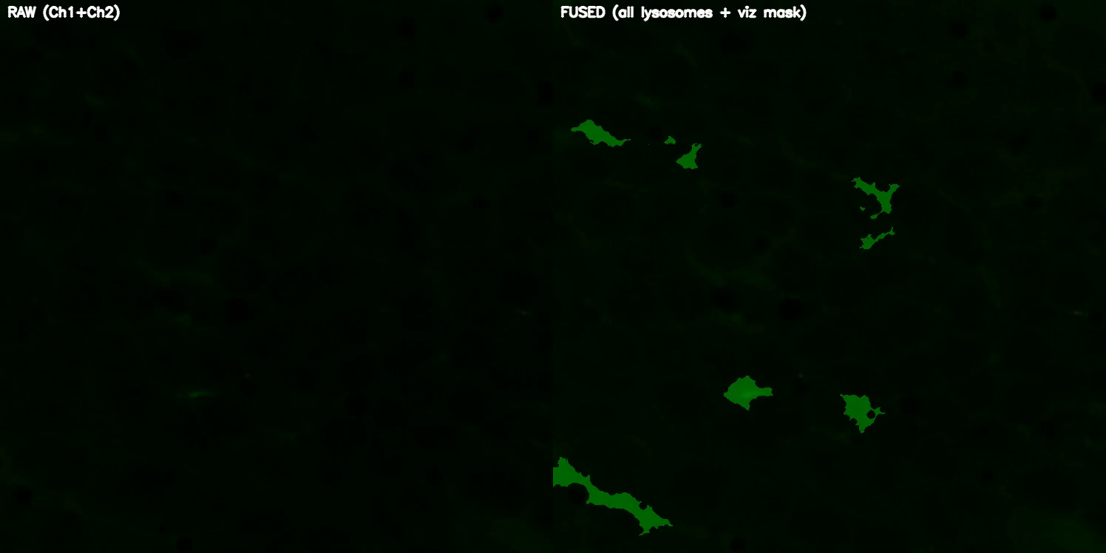
DETECTION VIDEO

Slide 5
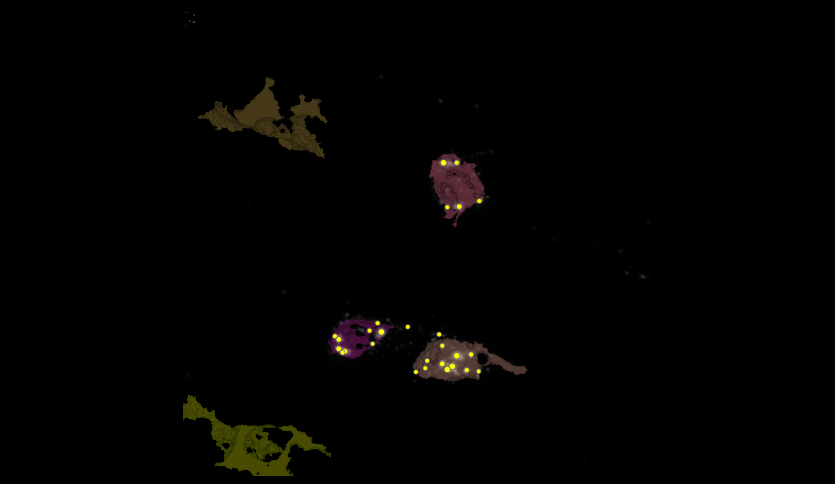
SEGMENTATION
78
151
148
155

Slide 6
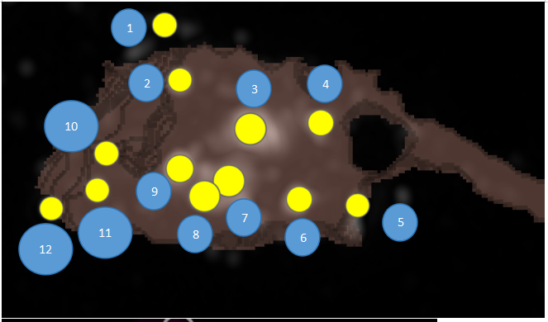
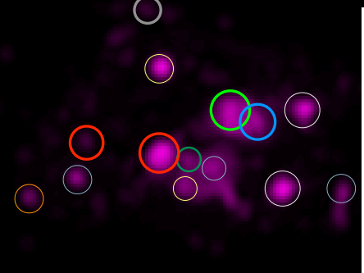
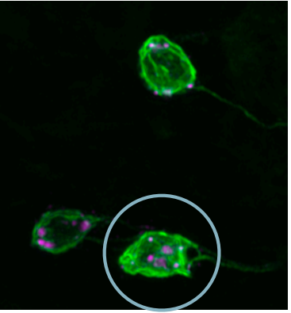
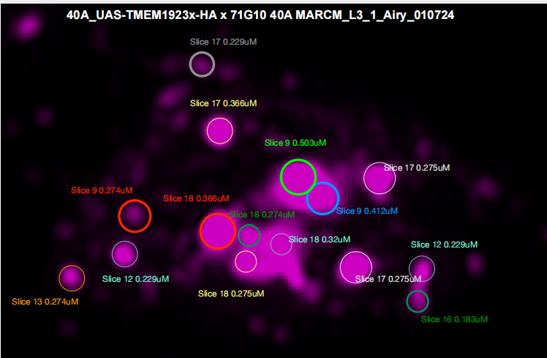
MANUAL.vs.AUTOMATIC
1
3
2
4
10
9
7
11
12
8
6
5

Slide 7
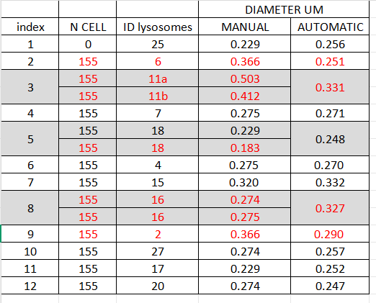
MANUAL.vs.AUTOMATIC

Slide 8
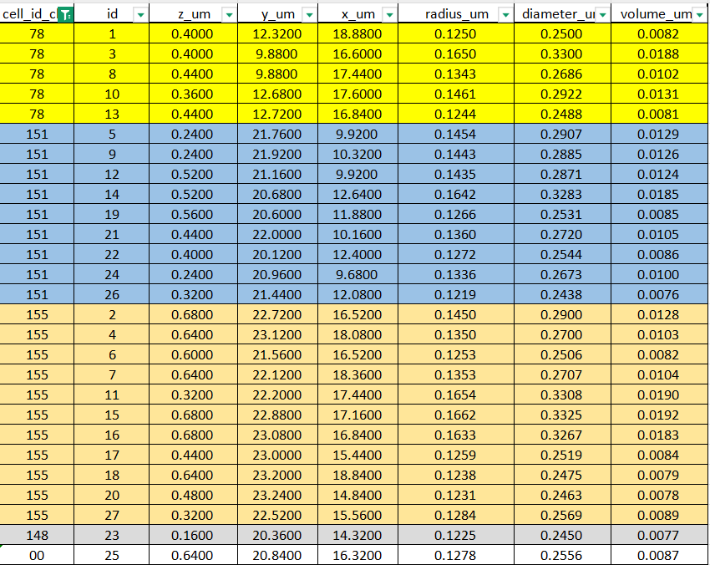
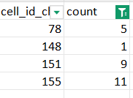
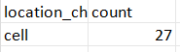
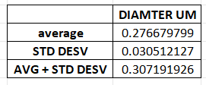
DATASET LYSOSOMES(ORDER FOR CELL ID)

Slide 9
Airy scan_40A_UAS-TMEM-HA_CB_0h_1_051222

Slide 10
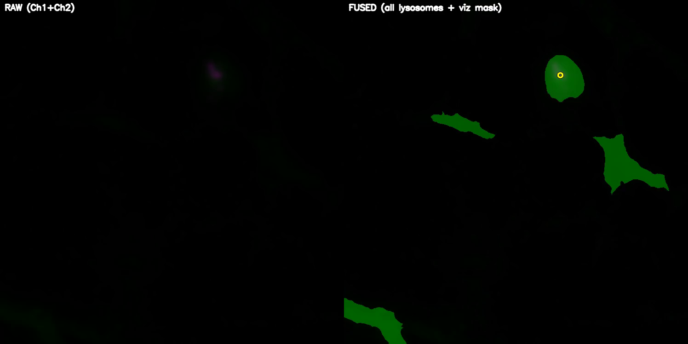
DETECTION VIDEO

Slide 11
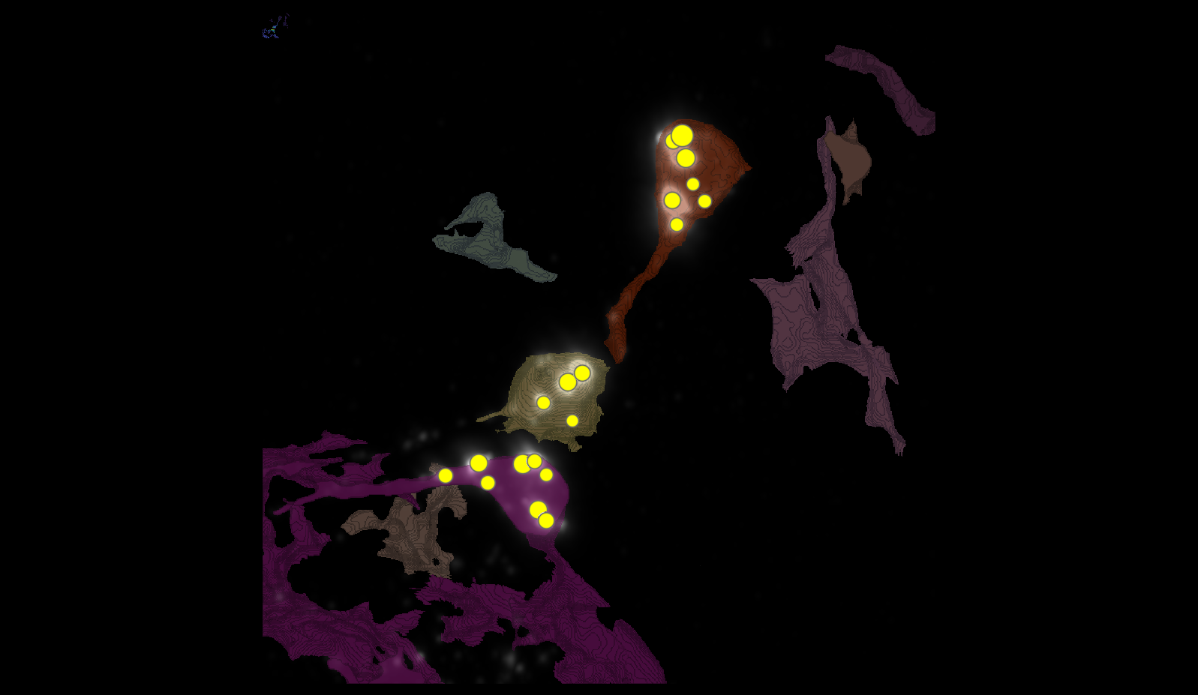
SEGMENTATION

Slide 12
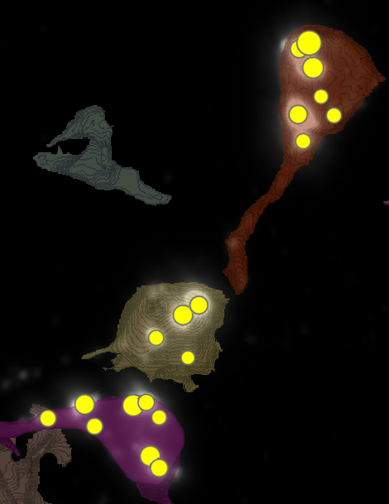
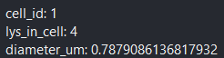
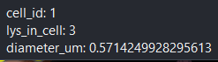
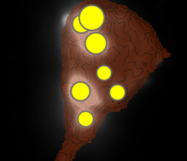
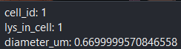
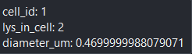
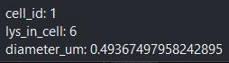
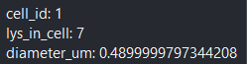
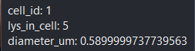
METRICS
1
6
4

Slide 13
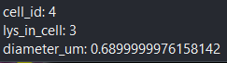
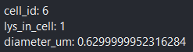
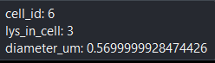

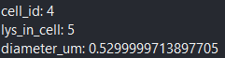
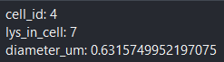

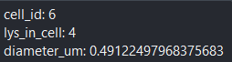
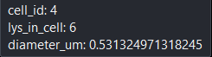
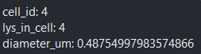
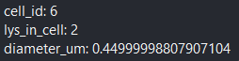
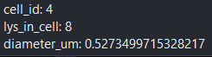
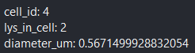
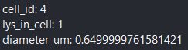
METRICS

Slide 14
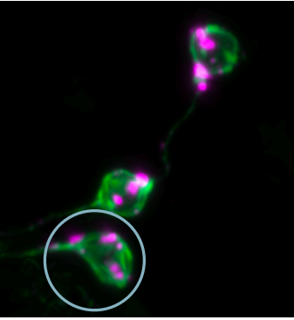
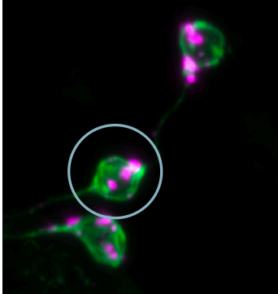
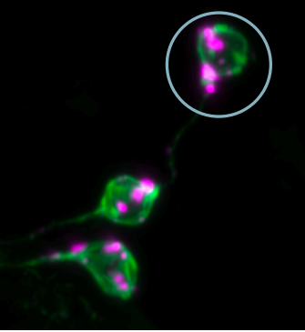
MANUAL.vs.AUTOMATIC

Slide 15
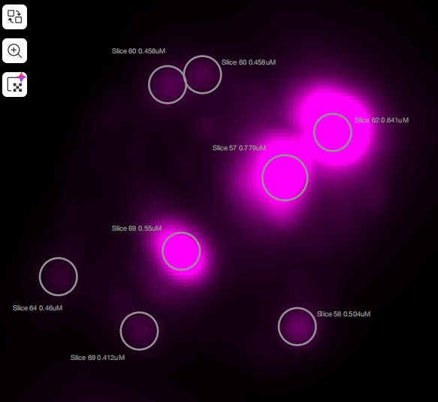
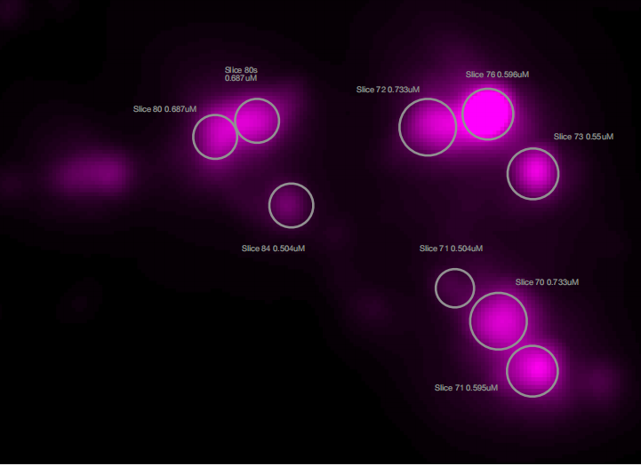
MANUAL.vs.AUTOMATIC
7
3
5
8
4
2
1

Slide 16
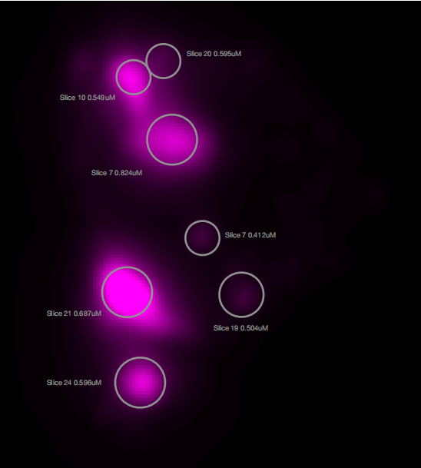
MANUAL.vs.AUTOMATIC

Slide 17
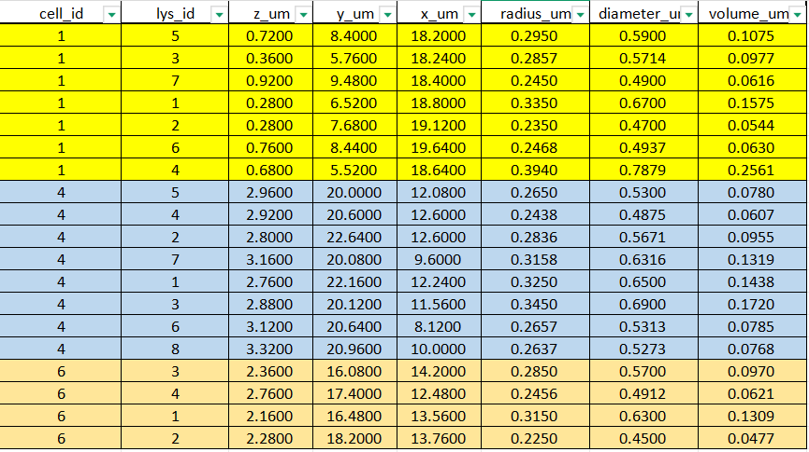
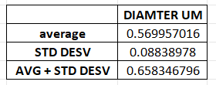
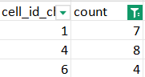
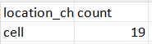
DATASETS

Slide 18
TMEM-HA 6h CB airy_3_170722

Slide 19
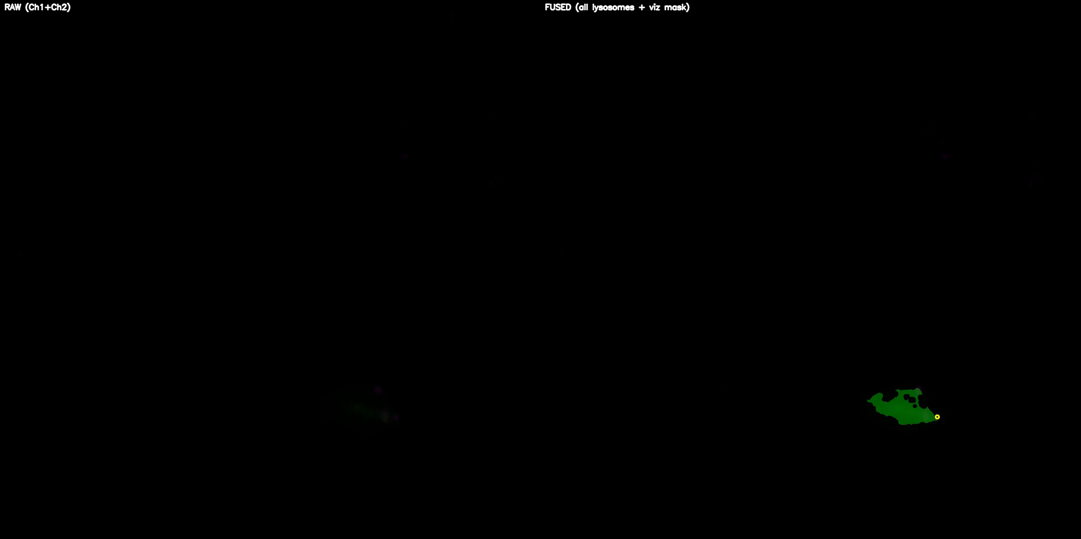
DETECTION VIDEO

Slide 20
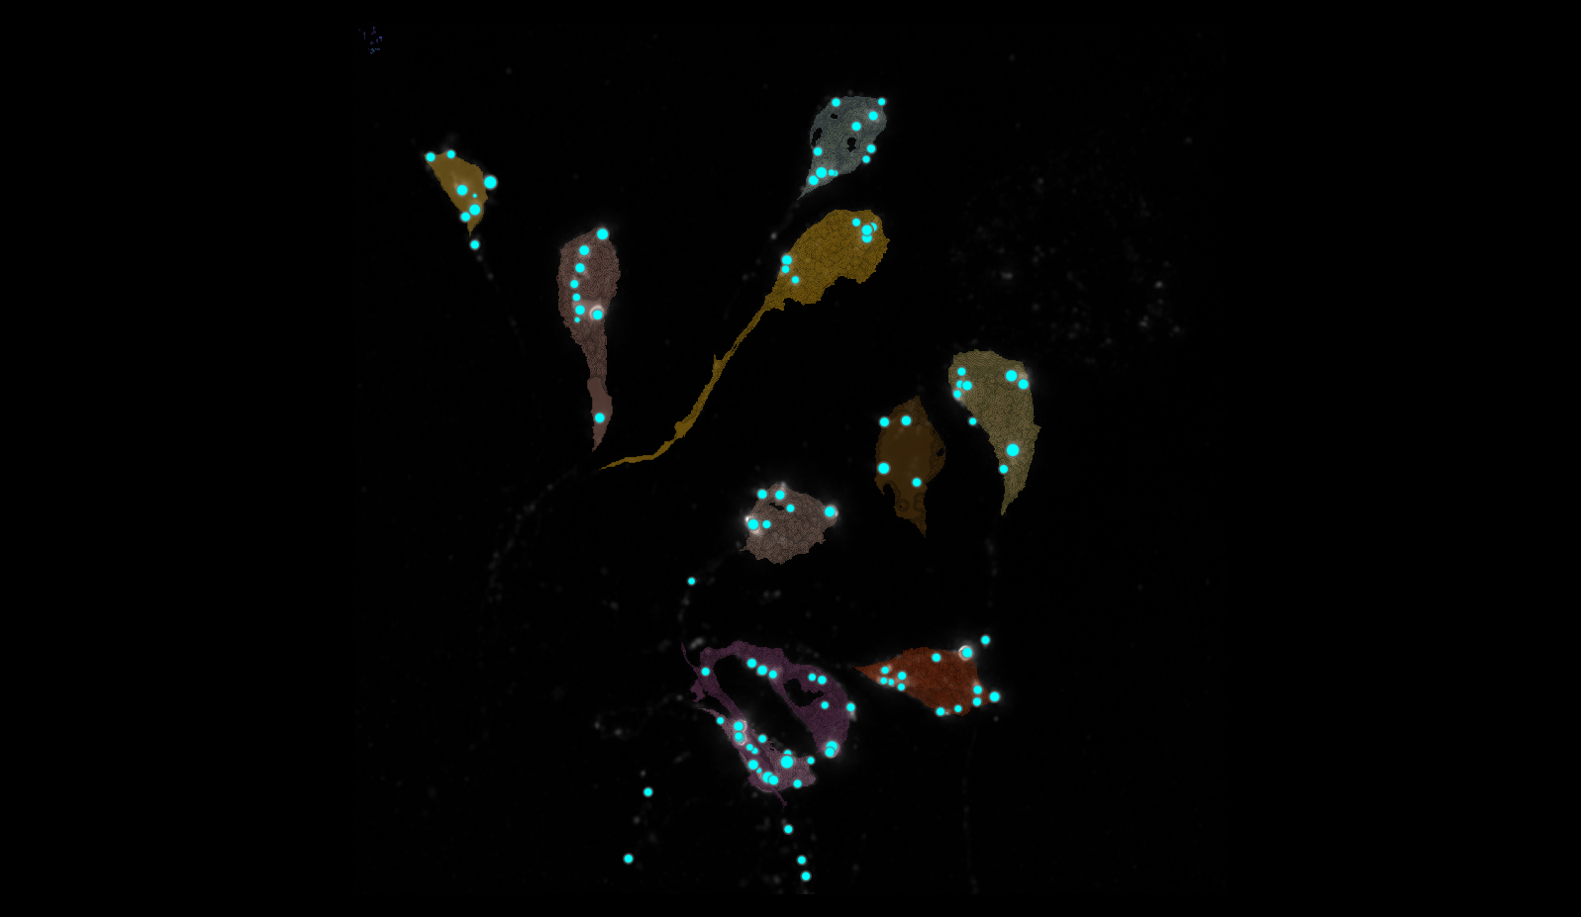
SEGMENTATION
24
2
9
8
6
7
15
1
3
5

Slide 21
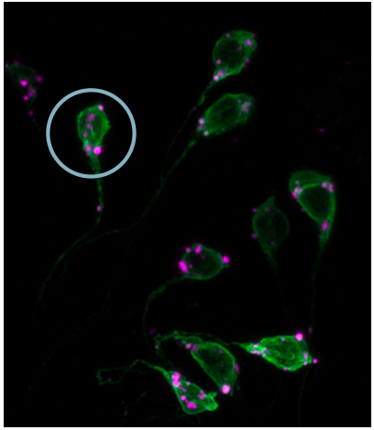
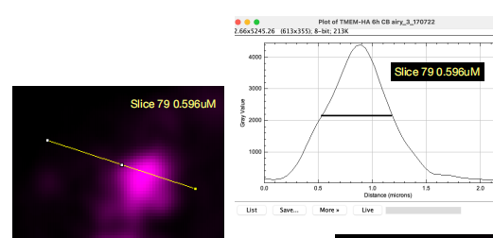
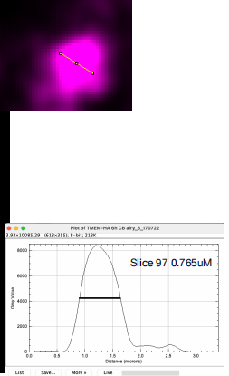
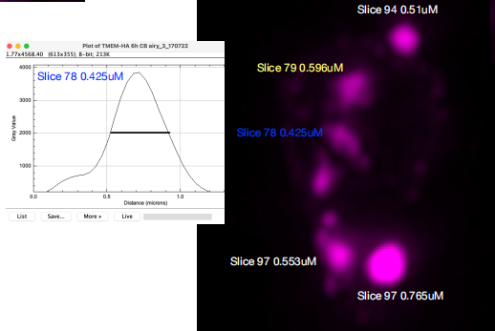

MANUAL.vs.AUTOMATIC

Slide 22

MANUAL.vs.AUTOMATIC

Slide 23





DATASET LYSOSOMES(ORDER FOR CELL ID)

Slide 24
40A_UAS-TMEM192-3xHA x 40A 71G10 MARCM_around 12h - for quantification_4 Airy-CBs_300425

Slide 25

DETECTION VIDEO

Slide 26

SEGMENTATION

Slide 27



MANUAL.vs.AUTOMATIC + DATASET LYSOSOMES
1 CELL, 3 LYSOSOMES
N CELL | ID LYSOSOMES | MANUAL DIAMETER UM | AUTOMATIC DIAMETER UM
3 | 1 | 0.504 | 0.45
3 | 2 | 0.412 | 0.39
3 | 3 | 0.366 | 0.391

Slide 28
40A_UAS-TMEM192-3xHA x 40A 71G10 MARCM_around 12h - for quantification_3 Airy-CBs_300425

Slide 29

DETECTION VIDEO

Slide 30

SEGMENTATION
2
18
35
39
38
65

Slide 31



MANUAL.vs.AUTOMATIC

Slide 32

MANUAL.vs.AUTOMATIC

Slide 33




DATASET LYSOSOMES(ORDER FOR CELL ID)

Slide 34

DATA ALL IMAGES
I used the image of 12H 4 and excluded that of 12H 3 because it only has one cell and 3 lysosomes, whereas 12H 4 has more cells and lysosomes, so it seemed more representative for the graph.

